Slide 1

SCI-FI VOICE ASSISTANT
Presented by :
MD SHAHBAZ KHAN USN:3LA19CS013
MD MISBAH MATEEN USN:3LA19CS012
YASEEN MALIK USN:9LA19CS019
Under the guidance of :
Asst. Prof. BASAVARAJ C Dept of computer science and engineering

Slide 2
CONTENTS:
Introduction
Project Description
Role in the Project
Things Learnt from the Internship
Snapshots
Conclusion

Slide 3
INTRODUCTION:
ARTIFICIAL INTELLIGENCE:
Artificial Intelligence (AI) broadly refers to any human-like behavior displayed by a machine or system.
MACHINE LEARNING:
Machine learning is a subset of AI. It focuses on the use of data and algorithms to imitate the way that humans gradually learn.
DATA SCIENCE:
Data science is the field of study that combines domain expertise, programming skills, and knowledge of mathematics and statistics to extract

Slide 4
PROJECT DESCRIPTION:
Problem Statement:
To write any documents, search for something, chat, access system applications, etc. need typing, pointing, or selecting which are hands-on work.
These works need to be done hands-free and automated.
Project Domain:
Voice Assistant is a very real application of Artificial Intelligence that uses Speech service to create natural, human-like conversational interfaces for applications and experiences
Functionality:
Can open YouTube, Gmail, and Google Chrome.
Predict the current time.
Predict the weather in different cities.
Can answer computational and geographical Questions too

Slide 5
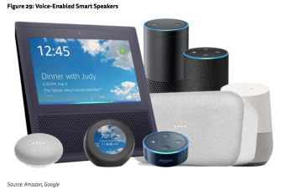
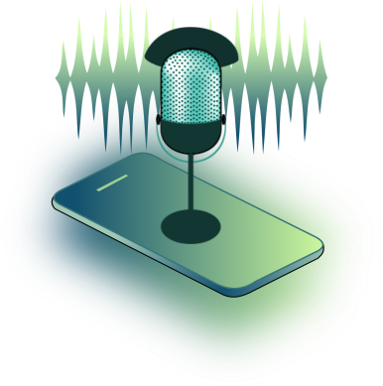

PROJECT DESCRIPTION:
Agenda:
Make people smart and give instant and computed results
AI Voice Assistant
This Project works on voice input and it gives output through voice and displays the text on the screen
Libraries Required:
Speech_Recognition
Pyaudio
Pyttsx3
Wolframalpha
Webbrowser

Slide 6
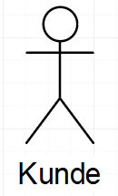
USE CASE:
WIKIPEDIA
OPEN GOOGLE
OPEN YOUTUBE
ACTOR
GOOGLE SEARCH
QUESTION
SECTION

Slide 7












SYSTEM ARCHITECTURE:
Record Voice By PyAudio
Mic
Say Command
Recognize Voice & Convert To Text By SpeechRecognition
Output Result Of Task As Speech By PyTtsX3
Save as a wav file
Perform Task Recognized from text
Save Result As Text

Slide 8



MY ROLE IN THE PROJECT:
Wake Up Assistant
Speech Recognized Text
Result
{ }
{ }
{ }
{ }
“open YouTube”
“time”
“wikipedia”
“hello buddy”

Slide 9
SNAPSHOTS:
Say “hello buddy” to wakeup the Assistant
Include “wikipedia“ in your command to get result for Wikipedia
To open YouTube, Google or Gmail , Say “open” with them

Slide 10
SNAPSHOTS:
Ask “weather” to get current weather report of city
“who are you” command gives self-description of assistant and “who made you” gives developer name
Say “can I ask” to ask any question to assistant and say “bye” to turn off
10

Slide 11
CONCLUSION:
Virtual assistant – a software agent that can perform tasks or services for an individual.
There are many virtual assistants around - Amazon Alexa, Apple's Siri, Google Now and Microsoft's Cortana.
Virtual assistants are on Peak on Inflated Expectations on Gartner Hype Cycle, and will be on Plateau of Productivity in 2 – 3 years in future.
The overall 1-month internship was good and very helpful in Artificial Intelligence. As it was a hands-on process it helped me to gain more technical skills.
One main thing that I have learned through this internship is time management skills as well as self-motivation.
I hope this experience will surely help me in my future and also in shaping my career.

Slide 12
REFERENCES:
From GeeksForGeeks - https://www.geeksforgeeks.org/python-create-a-simple-assistant-using-wolfram-alpha-api
From StackOverFlow- https://stackoverflow.com/questions/63134279/how-add-wake-up-function-in-python
From YouTube – https://youtu.be/AWvsXxDtEkU and https://youtu.be/Y5atyJbVsAU
From GitHub - https://github.com/ggeop/Python-ai-assistant

Slide 13

ANY QUESTIONS....?

